Slide 1
Case Study 2: Fine Dining Restaurant
By: Fox Wihlborg, Quashawn Turner, and Silvana Barrera

Slide 2
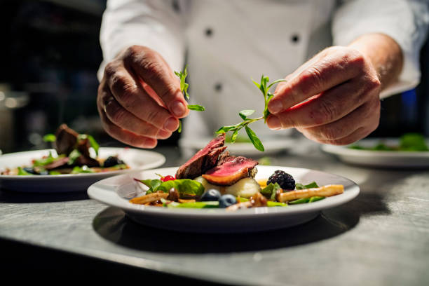
Business Idea: Fine Dining Restaurant
10 Steps for starting a fine dining restaurant
Plan business
Form a legal entity
Register for taxes
Open business account
Set-up accounting
Obtain permits/licenses
Obtain business insurance
Define brand
Create website
Business phone set-up
(TRUic, 2021)

Slide 3
What are our fixed and variable costs?
Fixed costs include rent, mortgage, salaries, loan payments, license fees, and insurance premiums. These costs are easier to budget for when opening a restaurant because they don’t fluctuate much each month.
Variable costs include food, hourly wages, and utilities. These costs are harder to predict when opening a restaurant because they vary according to output. After several months, you’ll know what to expect each month (Darlington, 2021).
The following table is utilizing $30 for fixed and variable costs. In addition average market price per meal being $21. TC=FC+VC and Total Revenue=Output*Market Price ($21). Total Profit is found by subtracting TC from TR.

Slide 4
Sample Fixed and Variable Costs Table
Output | 0 | 1 | 2 | 3 | 4 | 5 | 6 | 7 | 8 | 9 | 10 | 11 | 12 | 13 | 14
Fixed Cost | 30 | 30 | 30 | 30 | 30 | 30 | 30 | 30 | 30 | 30 | 30 | 30 | 30 | 30 | 30
Variable Cost | 0 | 12 | 22 | 30 | 36 | 44 | 54 | 66 | 80 | 96 | 114 | 134 | 156 | 180 | 206
Total Cost | 30 | 42 | 48 | 60 | 66 | 74 | 84 | 96 | 110 | 126 | 144 | 164 | 186 | 210 | 236
Total Rev. | 0 | 21 | 42 | 63 | 84 | 105 | 126 | 147 | 168 | 189 | 210 | 231 | 252 | 273 | 294
Total Profits | 30 | -21 | -6 | 3 | 18 | 31 | 42 | 51 | 58 | 63 | 66 | 67 | 66 | 63 | 58

